Slide 1
DropOut

Slide 2
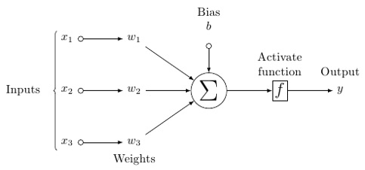
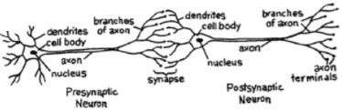
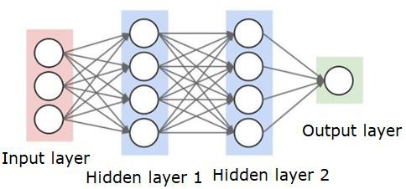
The Idea of Neural Networks

Slide 3
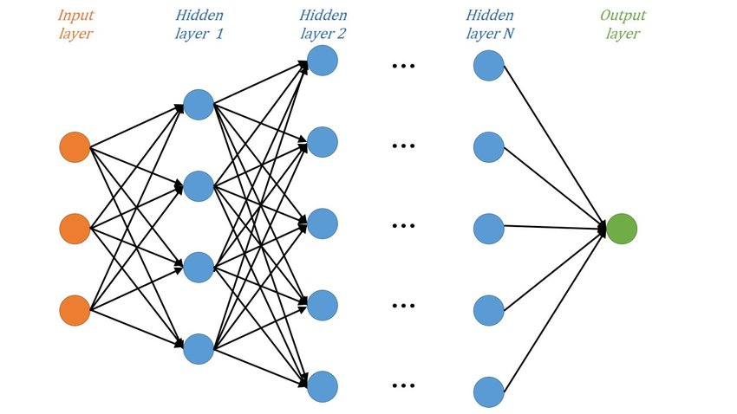
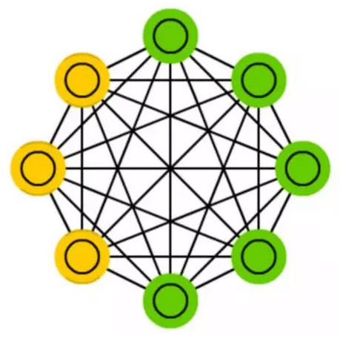
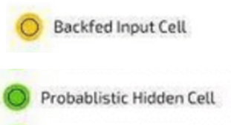
The Networks Discussed
Deep Neural Network (DNN) Boltzmann Machine (BM)

Slide 4
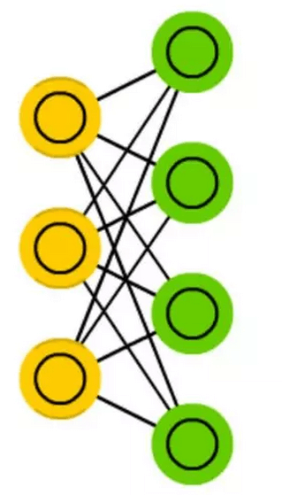
The Networks Discussed (contd.)
Restricted Boltzmann Machine (RBM)
In BM, a unit may act as input unit for feeding data or a hidden unit, and after the computations are complete, acts as an output unit.
Restriction:- No 2 units on the same layer are connected.

Slide 5
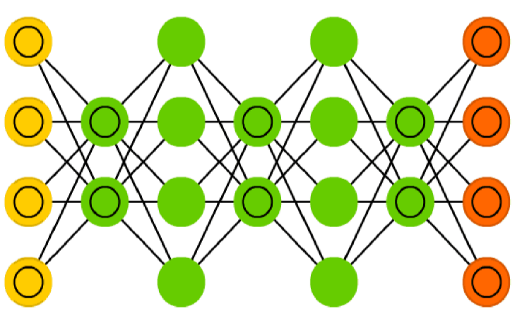




The Networks Discussed (contd.)
Deep Belief Network (DBN) Deep Boltzmann Machine (DBN)
Have undirected connections between layers
Some layers have directed connections

Slide 6
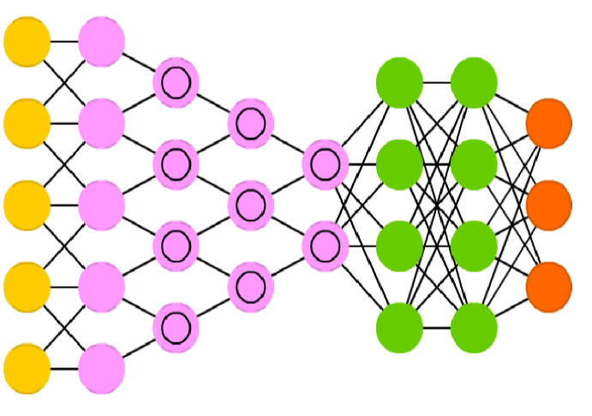

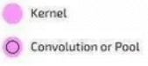


The Networks Discussed (contd.)
Deep Convolutional Network (DCN)
Convolution kernels are actually used to process incoming data, and pooling layers are used to simplify them (in most cases using nonlinear equations such as max) to reduce unnecessary features.
They are usually used for image recognition.

Slide 7
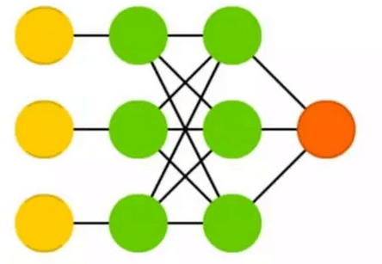
The Networks Discussed (contd.)
Support Vector Machine (SVM)
Used for Classification and regression, where the machine creates a hyperplane that separates the classes of data.
The hyperplane is constructed such that there is largest distance between the plane and any data point in the different classes, effectively reducing generalizations.

Slide 8
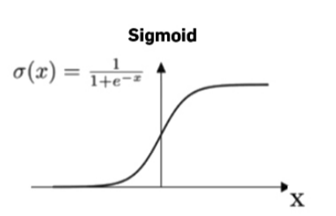
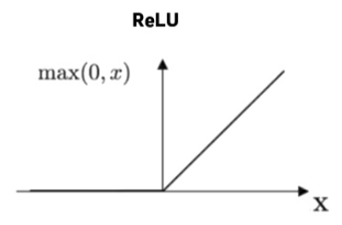
Units used in the Network
Logistic Unit Rectilinear Unit (ReLU)
ReLU is better than a logistic unit cause it prevents the problem of vanishing gradient while training in backpropagation.
Notes:
Mention Motivation and Previous Work

Slide 9
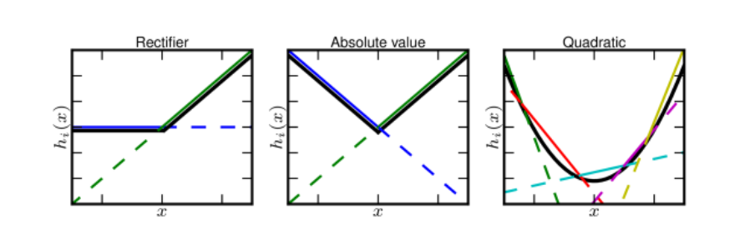
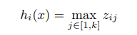
Units used in the Network (contd.)
Maxout Unit
Notes:
Mention Motivation and Previous Work

Slide 10
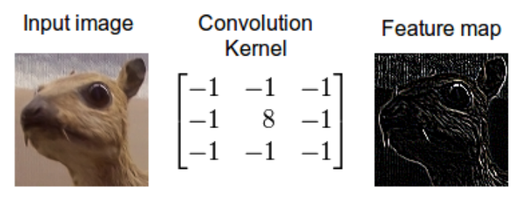
Units used in the Network (contd.)
Convolution Unit in DCN
Notes:
Mention Motivation and Previous Work

Slide 11
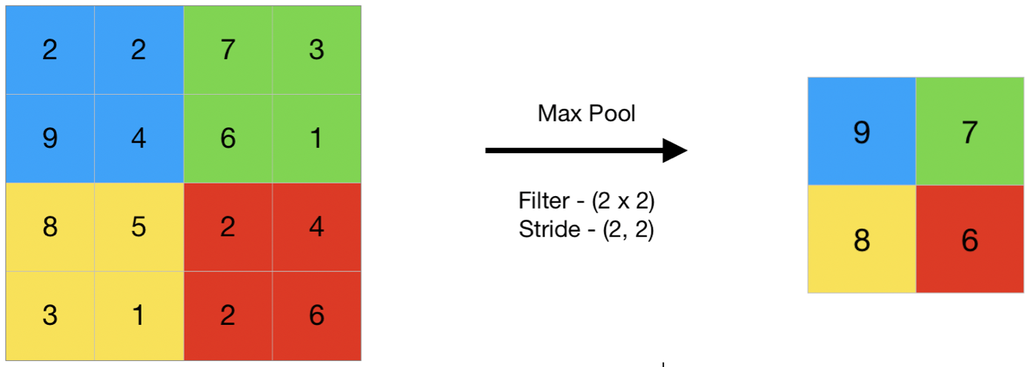
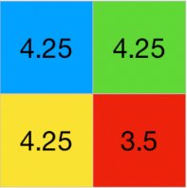
Units used in the Network (contd.)
Max and Average Pooling in DCN
Max pooling
Average pooling
Notes:
Mention Motivation and Previous Work

Slide 12
Dropout: A Simple Way to Prevent Neural Networks from Overfitting
Srivastava N, Hinton G, Krizhevsky A, Sutskever I, Salakhutdinov R (2014)

Slide 13
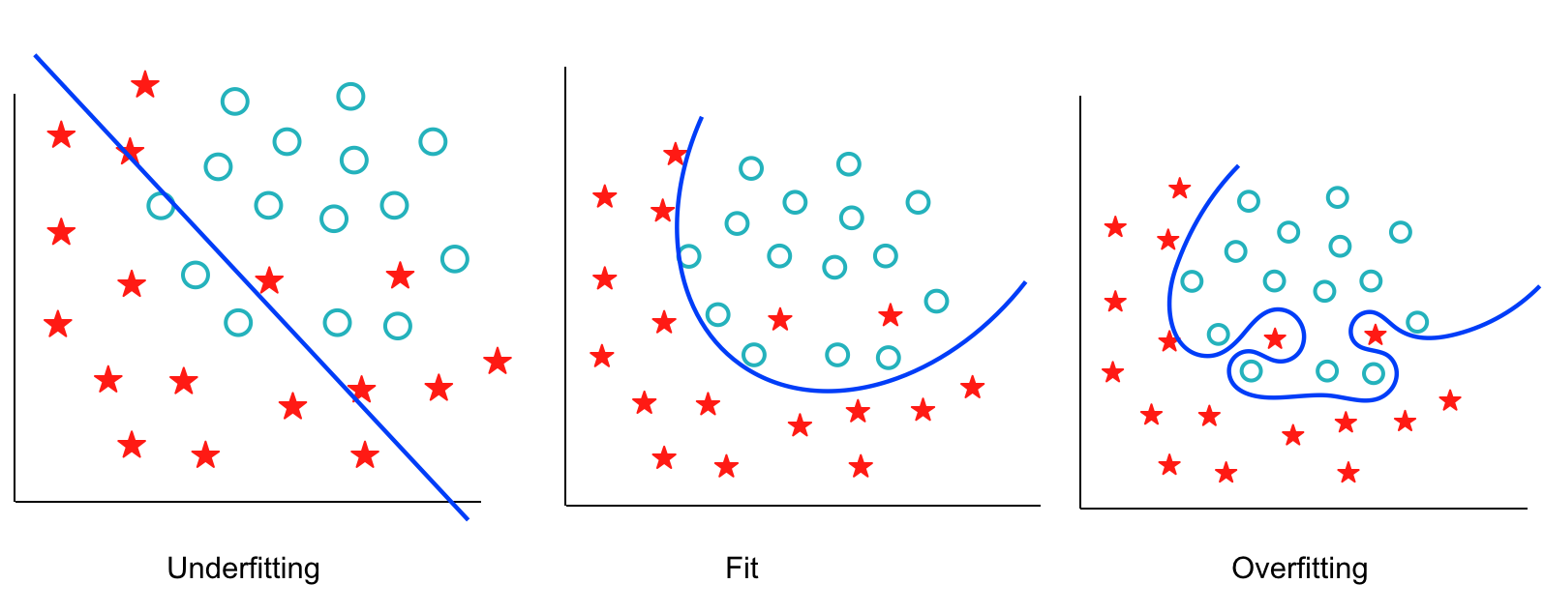
Introduction: Problems arising while training networks
If the training data set is small, the problem is that the network may memorize the training dataset. Instead of learning a general mapping from inputs to outputs, the model may learn the specific input examples and their associated outputs. This is termed as overfitting.

Slide 14
Existing methods of reducing Overfitting
Stopping the training as soon as performance on a validation set starts to get worse
Introduction of weight penalties:
L1 and L2 regularizations:- L1 adds absolute value of the parameters, while L2 adds the squared value of parameters to the cost function.
Soft weight sharing (Nowlan and Hinton, 1992)

Slide 15
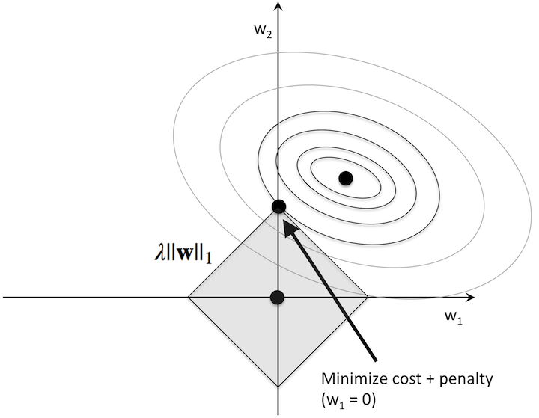
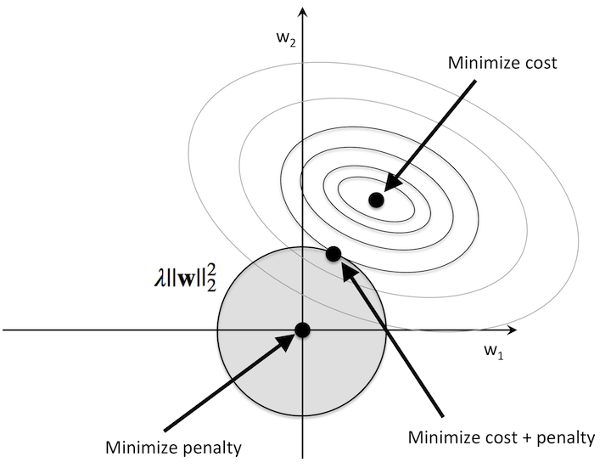
Existing methods of reducing Overfitting

Slide 16
Existing methods of reducing Overfitting (contd.)
Another option is to average the outputs obtained by varying the possible set of parameters and weighing against its posterior probability. Doing so would be easier for a smaller network.
For larger networks, it would be easier to train the separate models if they had different architectures (too many parameters to set), or be trained on different data (not enough data).

Slide 17
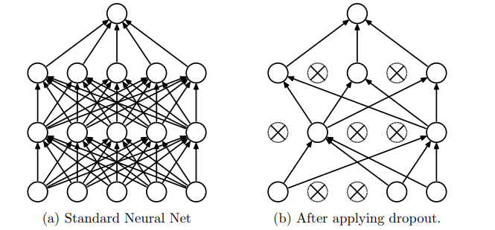
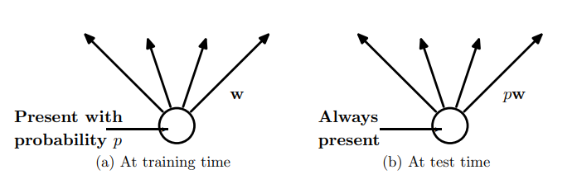
DropOut
p is closer to 1 for optimal outputs
DropOut can be considered as training thinned networks. Every network in this system rarely gets trained, if at all.
Or multiply weights with 1/p during training and retain w during testing
Notes:
Mention Motivation and Previous Work

Slide 18
DropOut (contd.)
DropOut can be seen as regularizing a neural network by adding noise to its hidden units.
Minimizing the loss function stochastically under a noise distribution.
Notes:
Mention Motivation and Previous Work

Slide 19
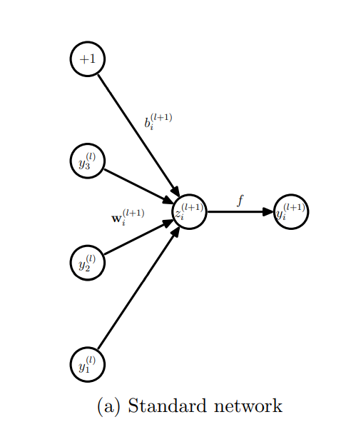
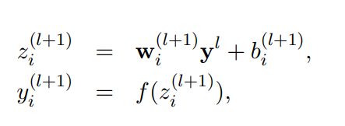
Model Description- Standard NN

Slide 20
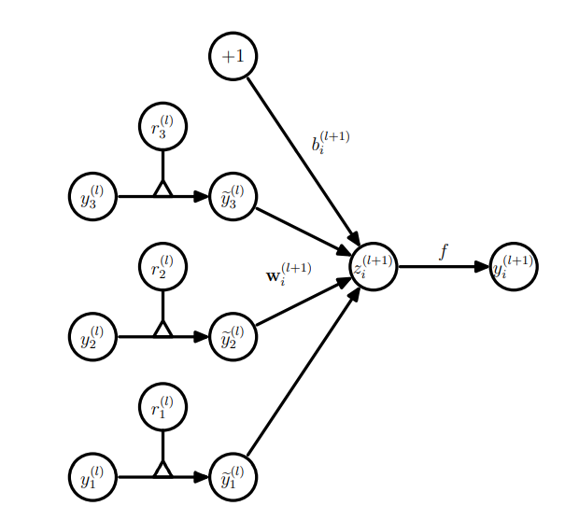
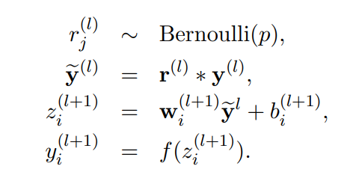
Model Description- DropOut NN
The p value here is selected by the user, based on some validation set, or naïvely set to 0.5.

Slide 21
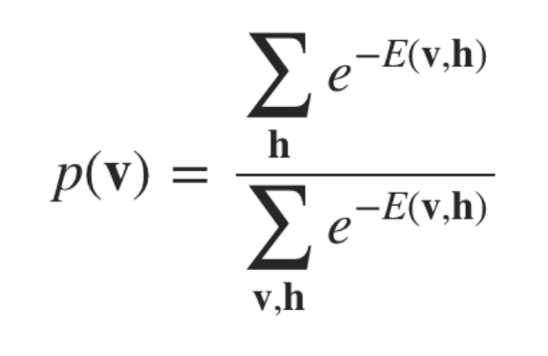
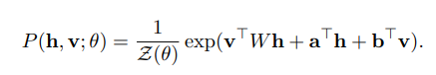
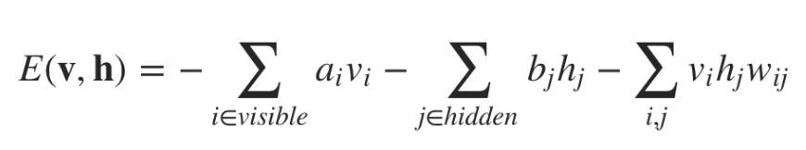
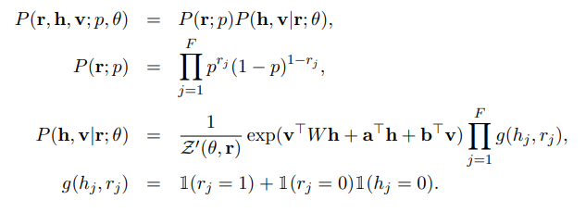
Model Description- RBM
Standard RBM
DropOut RBM
a and b are hidden and visible layer bias respectively

Slide 22
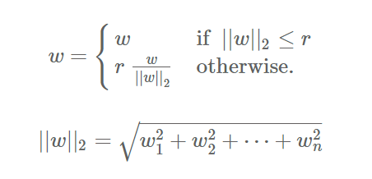
Training DropOut Network
Backpropagation:
Trained using stochastic gradient descent of the parameters.
Max-norm regularization is constricting the norm of the incoming weight vector (||w||2 ≤ c) to be upper bounded by some constant c (prevents the weights from blowing up when learning rates are high).
Notes:
Mention Motivation and Previous Work

Slide 23
Training DropOut Network (contd.)
Unsupervised Pretraining:
Train the network with a data set A. Initialise parameters of the model wrt A. Take a new data set B and finetune the pre-set parameters wrt B.
The weights obtained from pretraining should be scaled up by a factor of 1/p. This makes sure that for each unit, the expected output from it under random dropout will be the same as the output during pretraining
Notes:
Mention Motivation and Previous Work

Slide 24
Experiments
Image based data sets
MNIST
SVHN
CIFAR-10/100
ImageNet
Speech based data sets
TIMIT
Genetics based
Alternative splicing
Text based data sets
Reuters-RCV1
Notes:
Mention Motivation and Previous Work

Slide 25
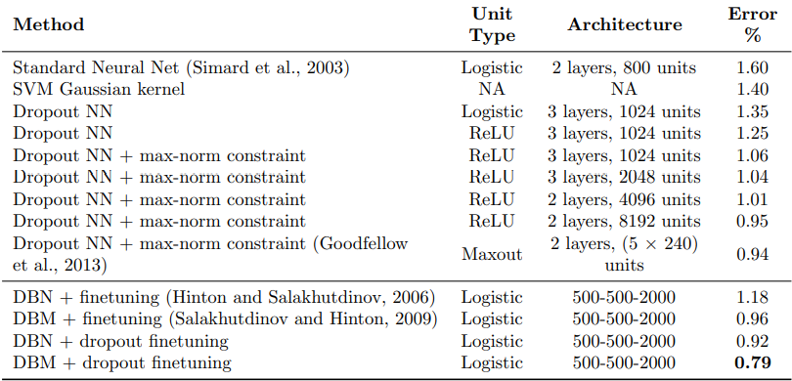
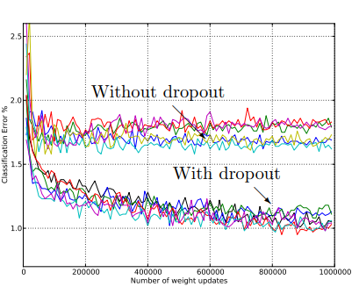
Results
MNIST (Image)
Test error
Notes:
Mention Motivation and Previous Work

Slide 26
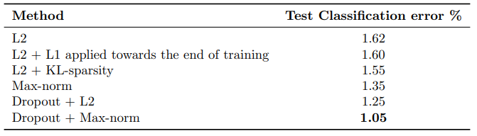
Results (contd.)
MNIST (Image) - Different regularization methods
Notes:
Mention Motivation and Previous Work

Slide 27
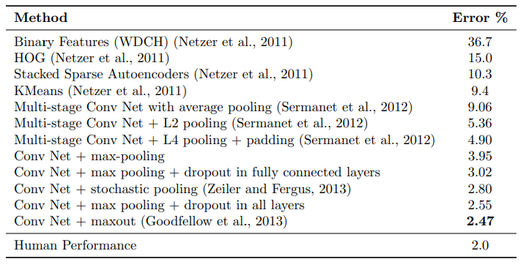
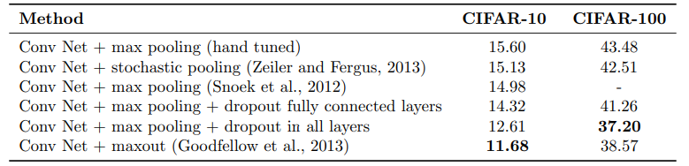
Results (contd.)
Street View (Image)
CIFAR 10/100 (Image)
Notes:
Mention Motivation and Previous Work

Slide 28
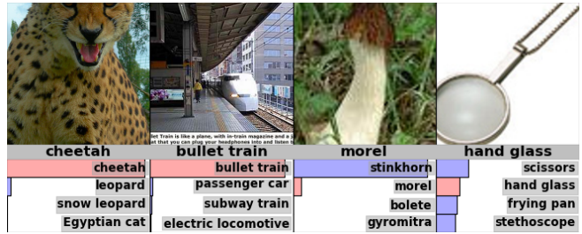
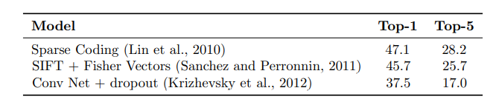
Results (contd.)
ImageNet (Image)
Data set of ImageNet
Notes:
Mention Motivation and Previous Work

Slide 29
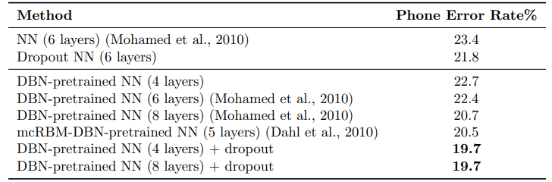
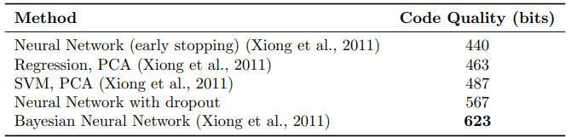
Results (contd.)
TIMIT (Speech)
Alternative Splicing (Genetics)
Notes:
Mention Motivation and Previous Work

Slide 30
DropOut v/s Bayesian Neural Network
DropOut treats every model and parameter is weighted equally while taking an average.
This averaging can be replaced with the BNN, where each model is weighted taking into account the prior and how well the model fits the data.
Bayesian neural nets are slow to train and difficult to scale to very large network sizes. And the cost to get predictions from many large nets at test time becomes expensive. Dropout neural nets are much faster to train and use at test time.
In cases where the data set is small, PCA (reduces dimensionality)+ SVM/regression can be used, but dropouts can be trained without modifying the dimensions of input
Notes:
Mention Motivation and Previous Work

Slide 31
Features
Effects:-
on Features
on Sparsity
of DropOut rate
of Data set size
Notes:
Mention Motivation and Previous Work

Slide 32
Features (contd.)
Effect on Features
In a system without dropout, complex co-adaptations can lead to overfitting.
DropOut prevents this by making the present hidden units unreliable. This leads to reduction in generalization errors.
Then number of dead units in RBM is less than Standard NNs
Notes:
Mention Motivation and Previous Work

Slide 33
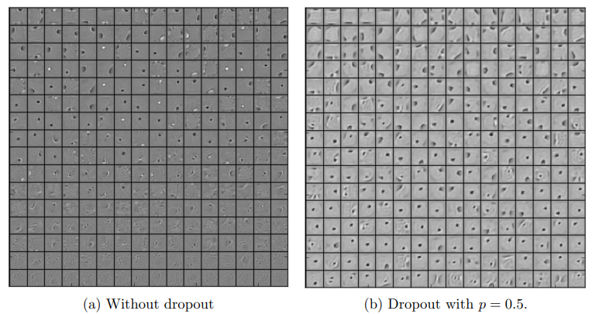
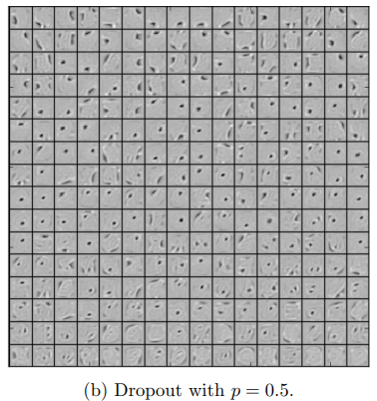

Features (contd.)
Effect on Features
RBM
Notes:
Mention Motivation and Previous Work

Slide 34
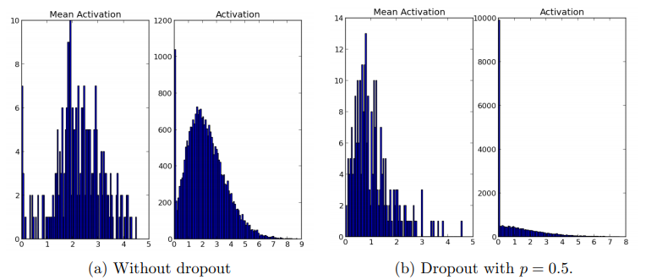
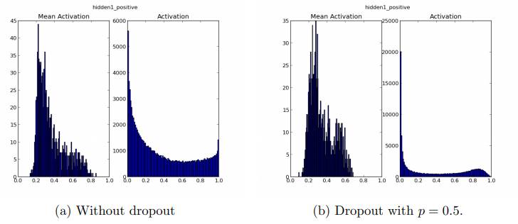
Features (contd.)
Effect on Sparsity (Standard NN)
Effect on Sparsity (RBM)
There should only be a few highly activated units for any data case. Moreover, the average activation of any unit across data cases should be low in a good sparse model.
Notes:
Mention Motivation and Previous Work

Slide 35
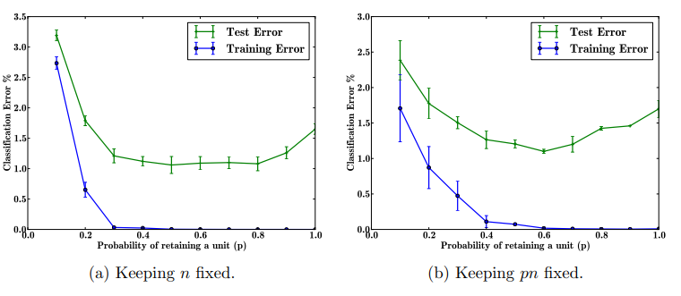
Features (contd.)
Effect of DropOut rate
If the architecture is held constant, having a small p means very few units will turn on during training. It can be seen that this has led to underfitting.
The networks that have small p will have a large number of hidden units. Therefore, after applying dropout, the expected number of units that are present will be the same across different architectures.
Notes:
Mention Motivation and Previous Work

Slide 36
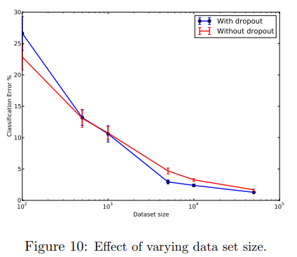
Features (contd.)
Effect of size of Data Set
p = 0.5 for hidden units and 0.8 for input layer
For smaller data sets, the network “memorises” the outputs regardless of the application of dropout.
For very large data sets, the addition of noise by dropout is overridden by overfitting.
This puts a constraint on the size of the data set
Notes:
Mention Motivation and Previous Work

Slide 37
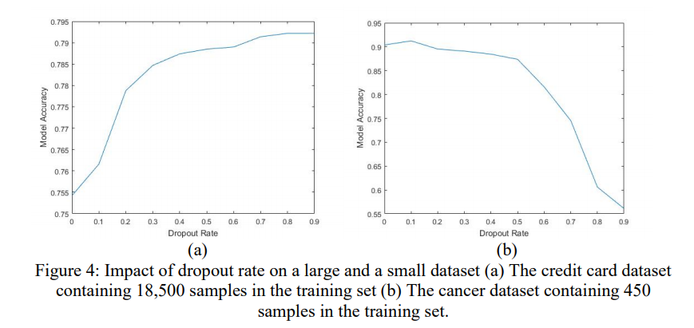
Features (contd.)
Effect of size of Data Set (Determining Optimum Drop-out Rate for Neural Networks)
Alexander Pauls
Josiah A Yoder
Notes:
Mention Motivation and Previous Work

Slide 38
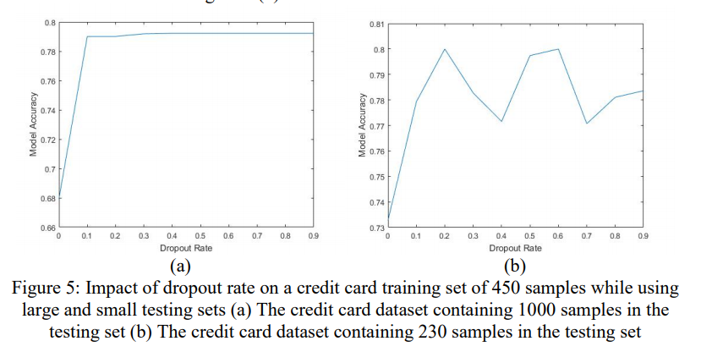
Features (contd.)
Effect of size of Data Set (Determining Optimum Drop-out Rate for Neural Networks)
Alexander Pauls
Josiah A Yoder
Notes:
Mention Motivation and Previous Work

Slide 39
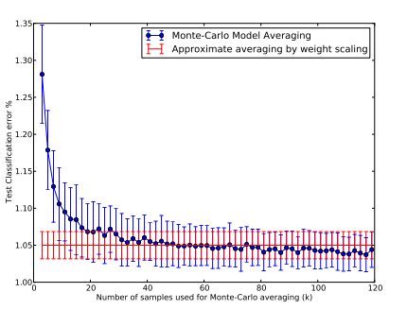
Weight Scaling v/s Monte Carlo method
A better and more correct approach in averaging the models after dropout is to use the Monte Carlo model, instead of the weight scaling.
The average is calculated over k neural networks.
The errors in the Monte Carlo averaging reduces to meet the true model average as k-> infinity.
Note: Both these averaging approaches are stochastic in nature
Notes:
Mention Motivation and Previous Work

Slide 40




Marginalizing Noise added by DropOut
Linear Regression:
Logistic Regression: unlike linear regression, the distributions over inputs and gradients are Gaussian in nature. The method out-performs Monte-Carlo averaging in terms of training time and generalization, but gets weaker as the number of hidden layers increase.
Notes:
Mention Motivation and Previous Work

Slide 41



DropOut with Multiplicative Gaussian Noise
Mean for Gaussian random variable is taken as 1 and the variance is given by (1-p)/p to correspond to the Bernoulli random variable. Variance becomes a tuneable parameter.
Notes:
Mention Motivation and Previous Work

Slide 42
Conclusion
DropOut improves performance of a standard neural network, as well as graphical models such as RBMs.
Major drawback is the increase in training time, due to noisy parameter updates.
A valid trade-off between increased training time and reducing overfitting.
A way to reduce the training time :- marginalise the noise to get a regularizer to obtain same results as dropout (for linear regression :- L2 regularization).
Notes:
Mention Motivation and Previous Work

Slide 43

How Convolution Network Works
Every layer in the CNN would choose a kernel which would detect specify features.
The deeper layers in DCN can detect complex features.

Slide 44

How Convolution Network Works (contd.)
3X3 kernel with strife 1. In the example dataset, Grayscale was used => one layer of kernel. RGB, each colour is convolved in each layer, giving 3 feature maps.
Padding is done if more number of operations are required (Feature map would of size 3X3 if padding was not applied.)

Slide 45

How Convolution Network Works (contd.)
Max-pooling prevents overfitting. (Finer details are not required to predict the correct output, prevents overfitting)
The above layers extract the features from the images and these are fed to a fully connected network to predict outputs.
How to Visualize Filters and Feature Maps in Convolutional Neural Networks (machinelearningmastery.com)

Slide 46

Averaging the parameters
Notes:
Mention Motivation and Previous Work

